Slide 1


MEDICAL STORE MANAGEMENT SYSTEM
SUBMITTED BY:
1.MANJUSHREE.
2.NAGA VENKATA SAI HARISH.
3.NARNE AVINASH.
4.NAZNEEN NIDHA.
5.NEHA APARAJ.

Slide 2

CONTENTS
INTRODUCTION.
SYSTEM REQUIREMENTS.
IMPLEMENTATION IN SAP/ABAP.
CONTEXT LEVEL DIAGRAM.
FUTURE SCOPE.

Slide 3
INTRODUCTION
The Medical Store Management System has been developed to override the problems prevailing in the practicing manual system.
The project mainly focuses on developing an application that can manage the sales, purchase, stock repository and other product related accounts of a medical store implemented using SAP.

Slide 4

SYSTEM REQUIREMENTS
Intel Pentium 90 or higher(P166 recommended).
Microsoft Windows 95,98, or NT 4.0, 2k, XP, Windows 2007 and above.
Memory: 32MB of RAM.
Internet Explorer 6.0 or higher.
Oracle 9i client and access to oracle 9i server or SQL Server Client and access to SQL Server.
Connectivity to SAP Server.

Slide 5
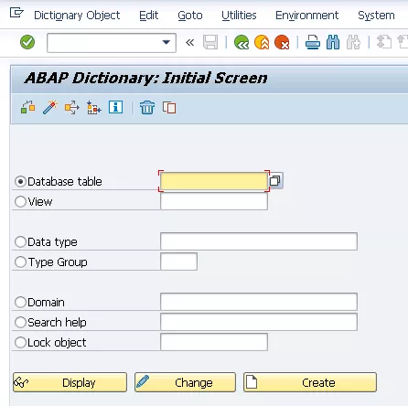
IMPLEMENTATIONS IN SAP/ABAP
TABLES:
ZMEDICINE_DATA1.
ZMEDICINE_SOLD1.
ZMED_LIST1.
ZPATIENT_DETAIL1.
ZPAYMENT_DETAILS1.
ZPUR_MED1.
ZSUPP_DETAILS1.
ZUSER1.
ZCUSTOMER1.
ZSEARCH1.

Slide 6
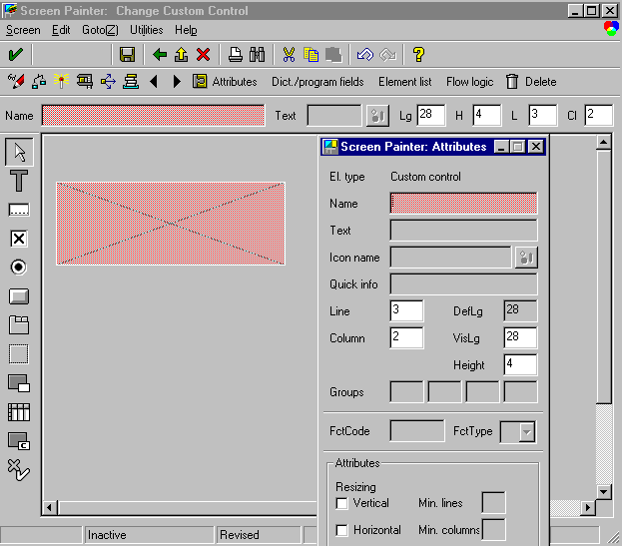
SCREENS
Login screen.
Order medicine screen.
Bill payment gateway screen.
Admin control page screen.
Medicine info screen.
Supplier details screen.
Gross profit screen.
Purchase medicine screen.
Day wise report of medicine sold screen.
Registration form screen.

Slide 7

FUNCTIONALITIES OF SAP ABAP USED
DATABASE TABLES.
SEARCH HELP.
SCREEN PAINTERS.
TABLE CONTROL.
TABSTRIPS.
SMARTFORMS.

Slide 8
CONTEXT LEVEL DIAGRAM
ADMIN
MEDICINE DETAILS
SUPPLIER DETAILS
SELLER
ORDER MEDICINE
GROSS PROFIT
PURCHASE MEDICINE
BILL PAYMENT
MEDICAL STORE

Slide 9
FUTURE SCOPE
It can reduce the time complexity by increasing efficiency through medical software application.
Reduces manual work flow.
It can perform day to day activities through business process accurately.
Greater accountability.
Keeps data secure.
It can store, retrieve, maintain the medical database system conveniently.

Slide 10

Thank you

